Slide 1
The Cyber “EOC”

Slide 2
Likelihood
Biggest global threats
1. Weapons of Mass Destruction
2. Failure to address climate change
3. Extreme Weather (Floods, earthquakes)
4&5 Data theft and cyber attacks
World Economic Forum 2019

Slide 3
Impact
Biggest global threats
1. Weapons of Mass Destruction
2. Failure to address climate change
3. Extreme Weather (Floods, earthquakes)
7. Large scale cyber attacks
World Economic Forum 2019

Slide 4
Ransomware hits – what do you do??

Slide 6
TIME OUT!!!!

Slide 7
Ransomware hits - Disconnect the network
Are you cyber eoc ready???
Who can Authorize a complete service disruption?
What is affected? Police? Fire? VoIP Phones? Payments?
How long can operations be sustained with no network?
Is each department prepared for analog operations?
Does budget exist for an emergency recovery response?
Who makes command decisions in a cyber attack?

Slide 8
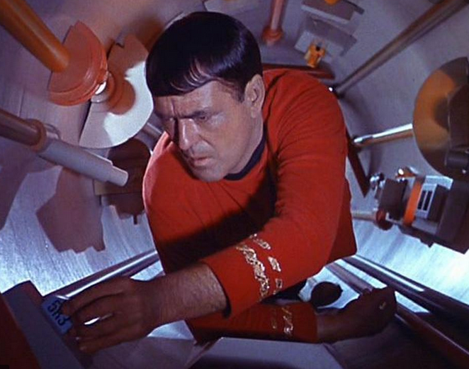

Slide 9
EOC Guidelines
Central command and control
Gather, collect and analyze data
Functions at a strategic level
Continuity of operation
Disseminate those decisions
Leave tactical decisions to lower commands

Slide 10
Thank You
Rick Balzer
rbalzer@intelesysone.com
888-546-8353
www.intelesysone.com

Slide 11
Ransomware hits - Disconnect the network
Are you cyber eoc ready???
Who can Authorize a complete service disruption?
What is affected? Police? Fire? VoIP Phones? Payments?
How long can operations be sustained with no network?
Is each department prepared for analog operations?
Does budget exist for an emergency recovery response?
Who makes command decisions in a cyber attack?

